Slide 1
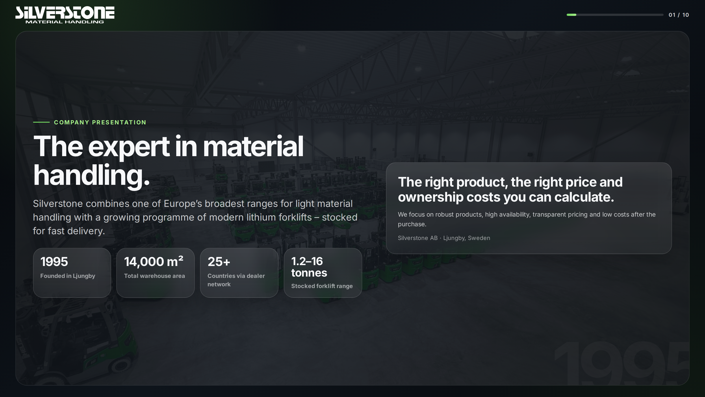
Notes:
Source: supplied Silverstone company presentation (HTML), original slide 1.

Slide 2
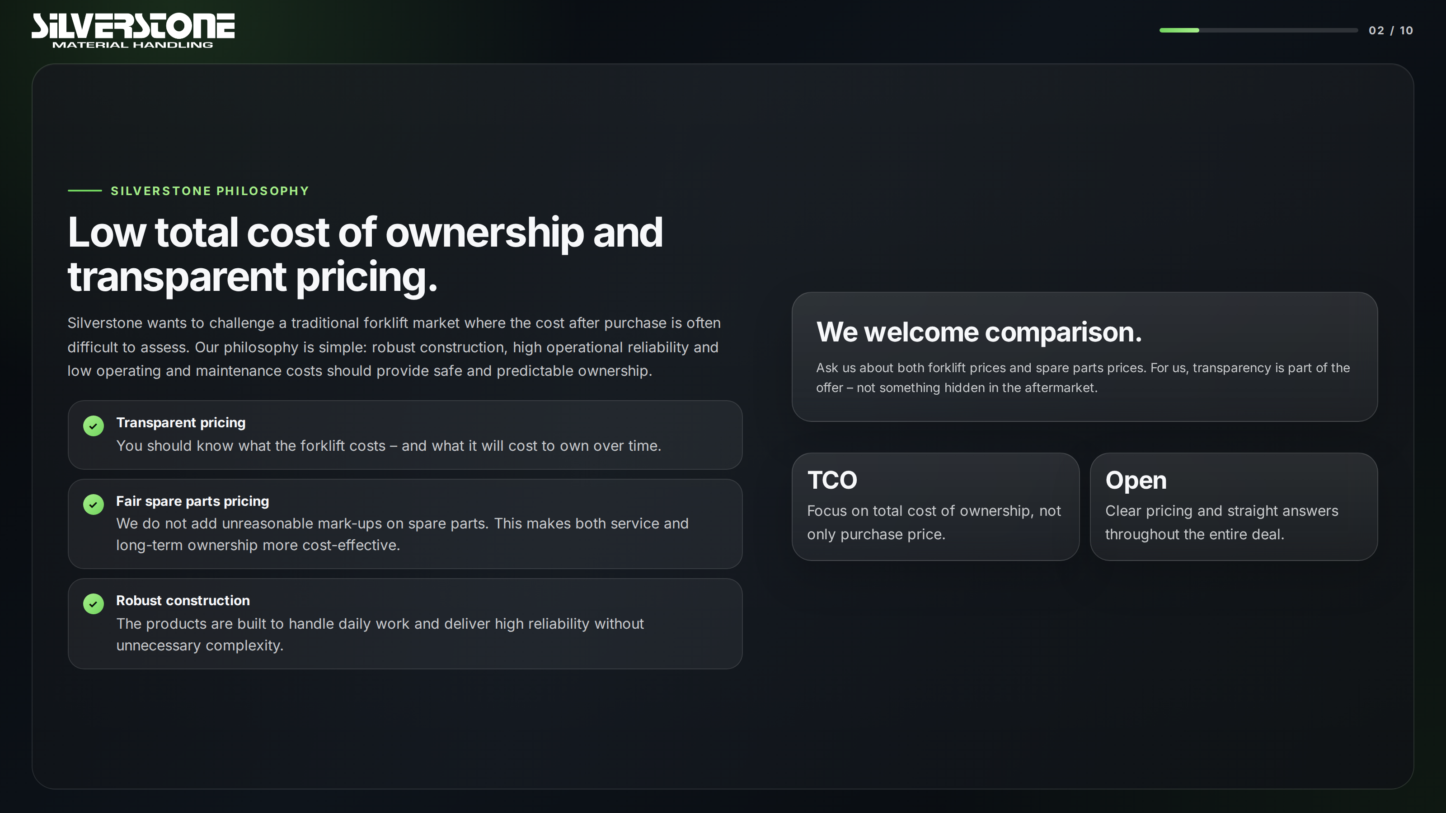
Notes:
Source: supplied Silverstone company presentation (HTML), original slide 2.

Slide 3
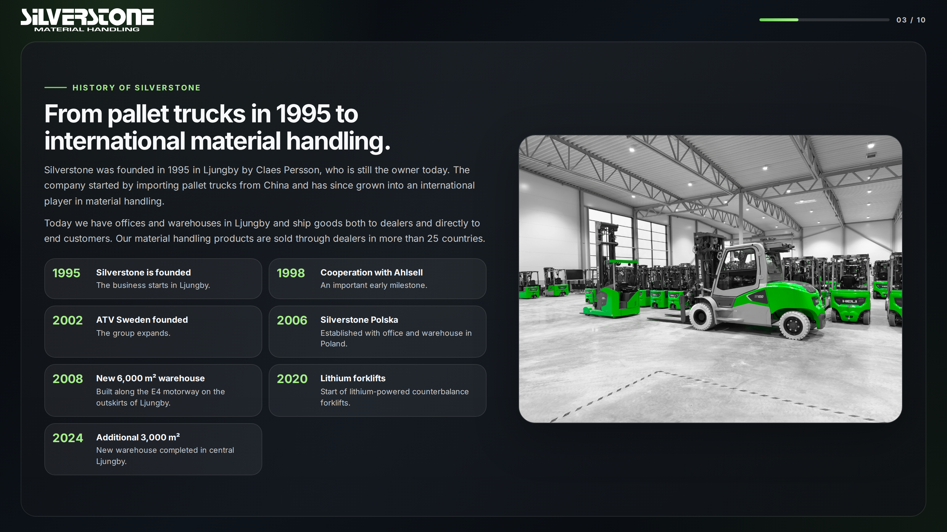
Notes:
Source: supplied Silverstone company presentation (HTML), original slide 3.

Slide 4
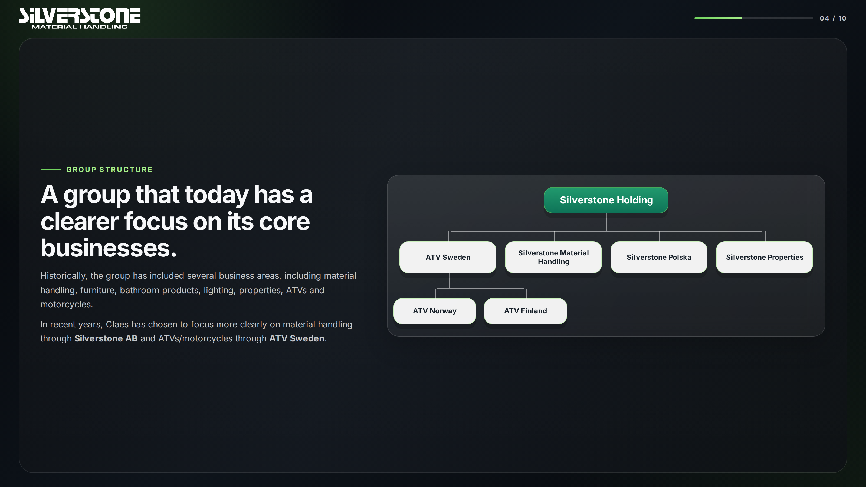
Silverstone Holding
ATV Sweden
Silverstone Material
Handling
Silverstone Polska
Silverstone Properties
ATV Norway
ATV Finland
Notes:
Source: supplied Silverstone company presentation (HTML), original slide 4.

Slide 5
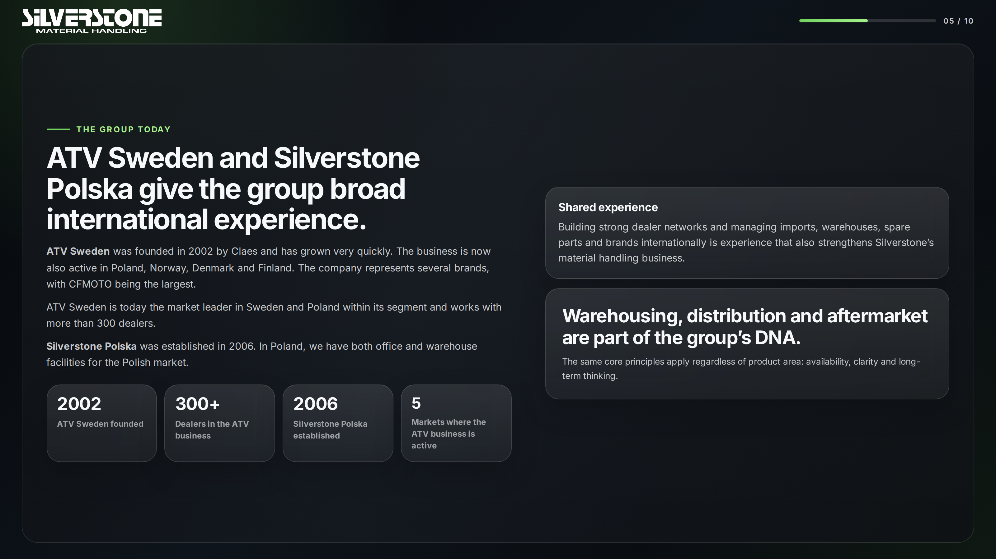
Notes:
Source: supplied Silverstone company presentation (HTML), original slide 5.

Slide 6
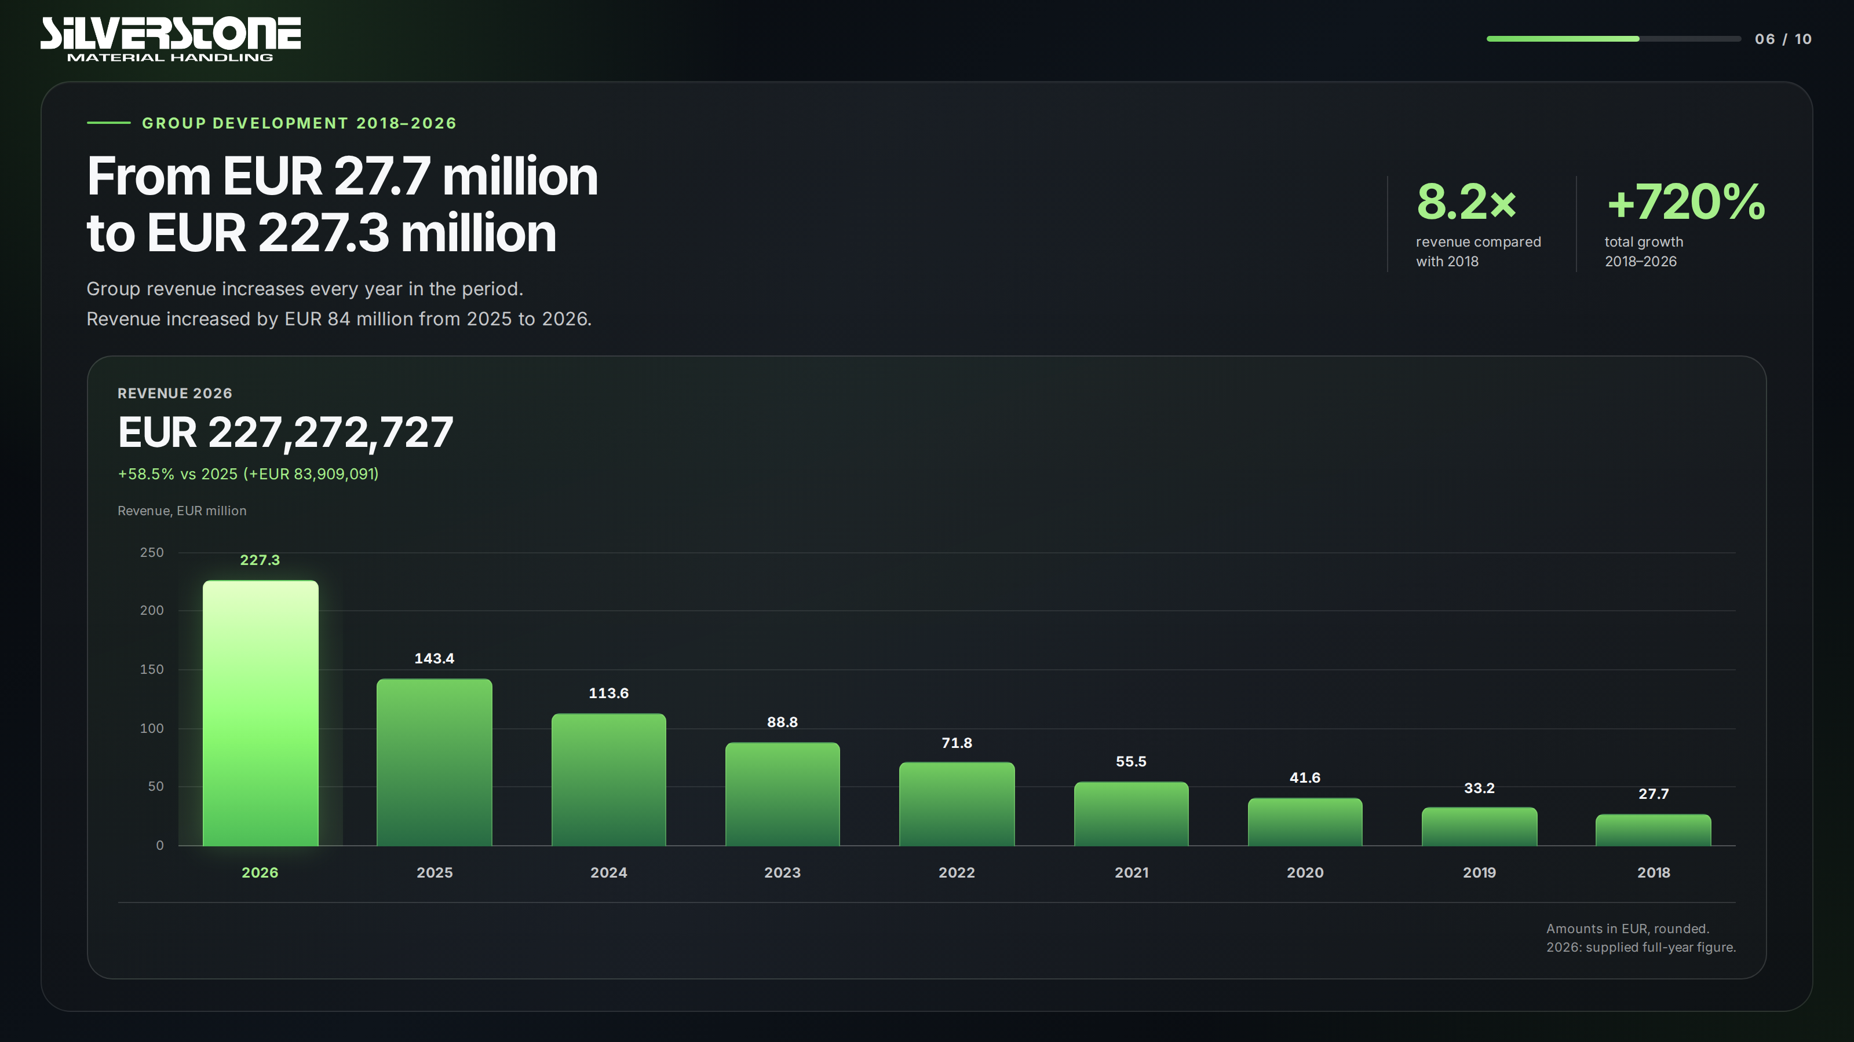
Notes:
Source: supplied Silverstone HTML presentation. Original revenue values in SEK: 2018: 305,000,000; 2019: 365,000,000; 2020: 458,000,000; 2021: 610,000,000; 2022: 790,000,000; 2023: 977,000,000; 2024: 1,250,000,000; 2025: 1,577,000,000; 2026: 2,500,000,000. EUR conversion in the supplied presentation: SEK / 11. 2026 is the supplied full-year figure. Annual change: 2019 19.7%, 2020 25.5%, 2021 33.2%, 2022 29.5%, 2023 23.7%, 2024 27.9%, 2025 26.2%, 2026 58.5%.

Slide 7
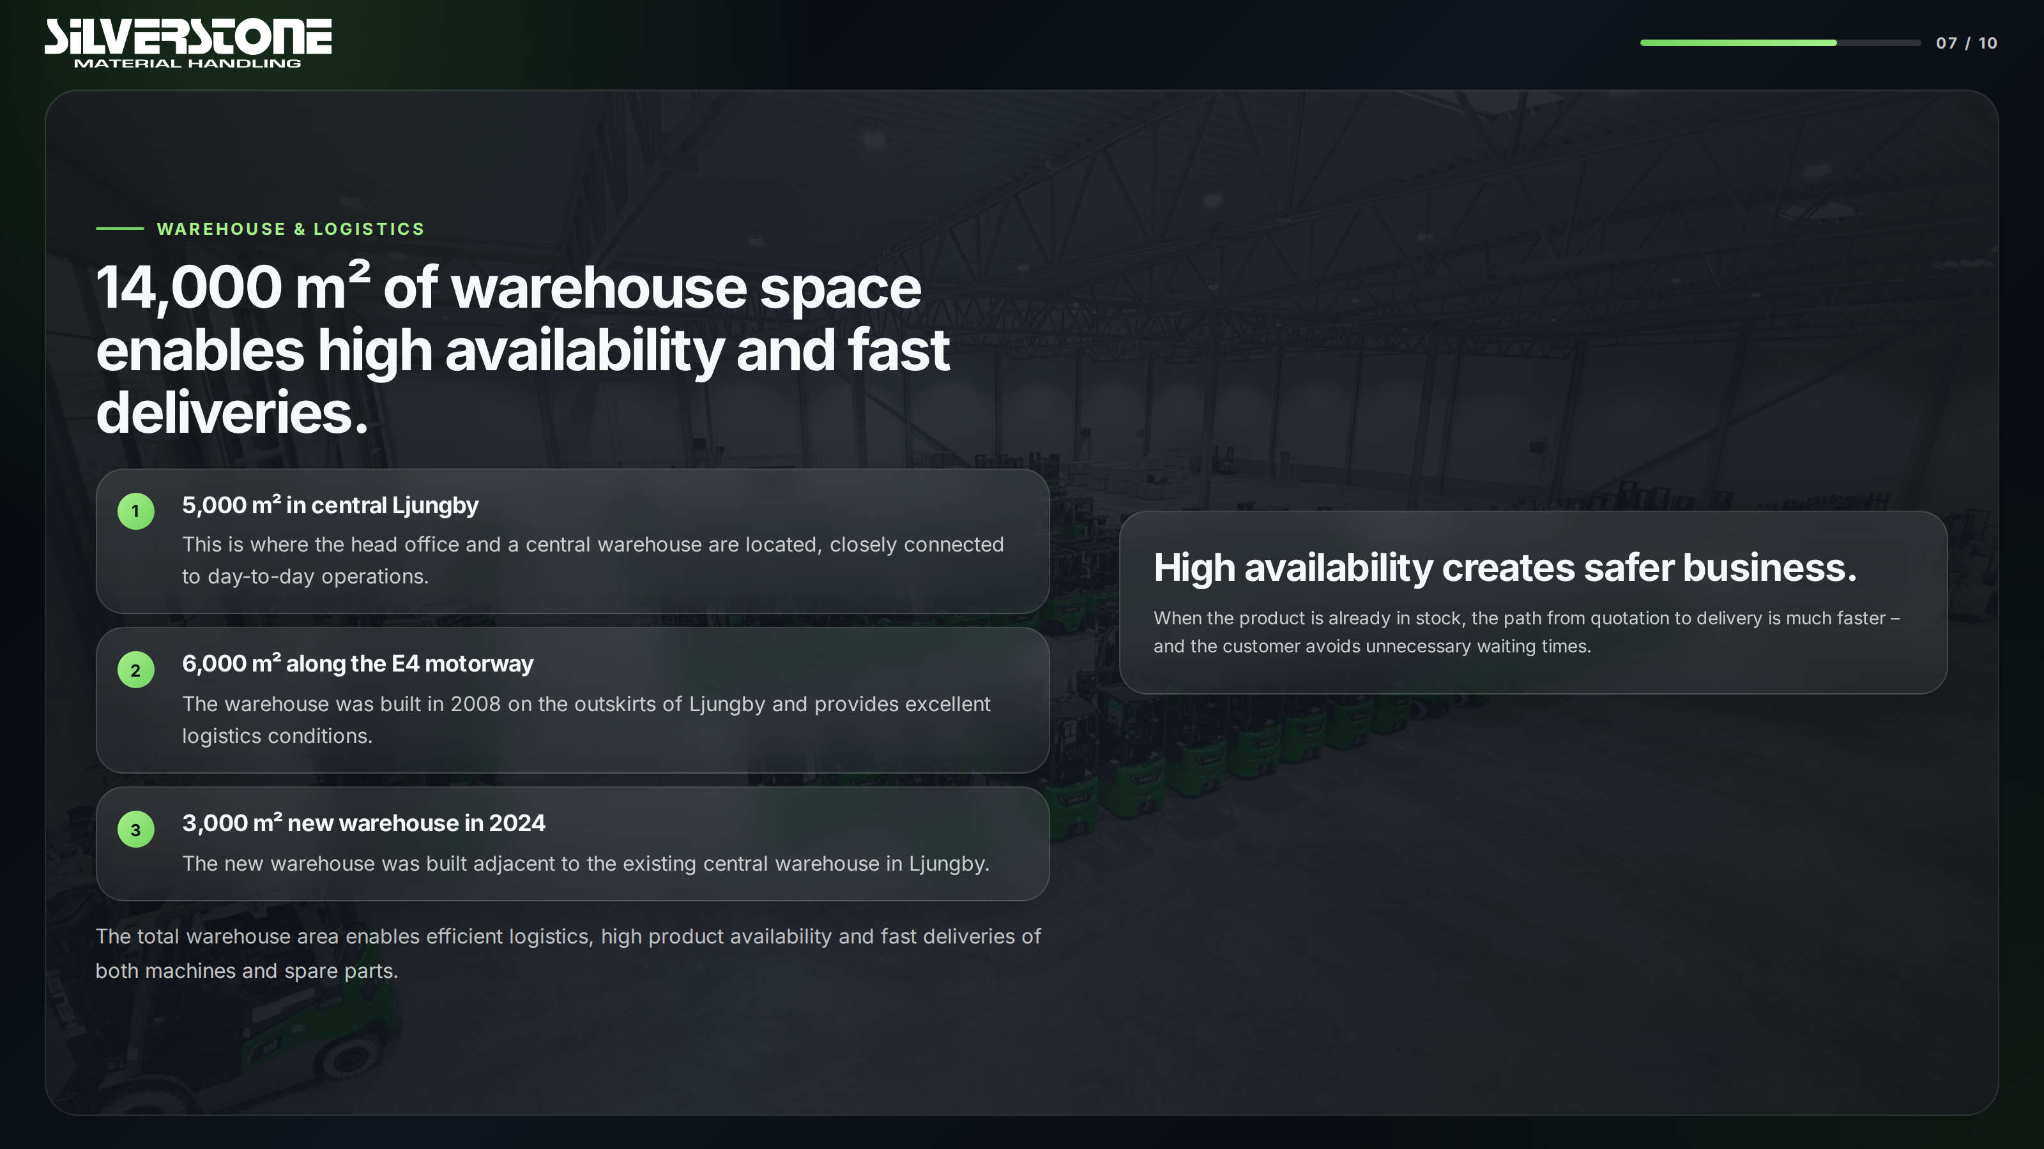
Notes:
Source: supplied Silverstone company presentation (HTML), original slide 7.

Slide 8
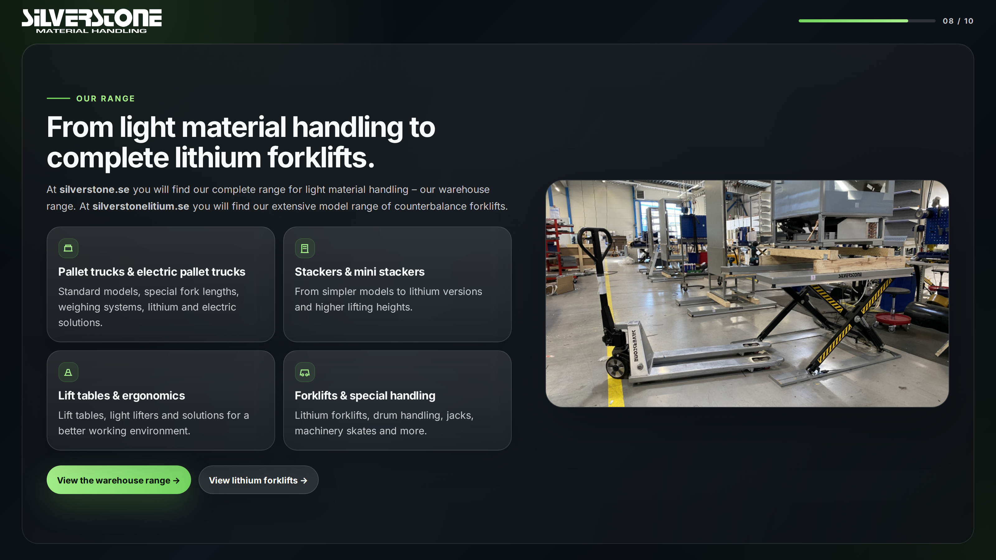
Notes:
Source: supplied Silverstone company presentation (HTML), original slide 8.

Slide 9
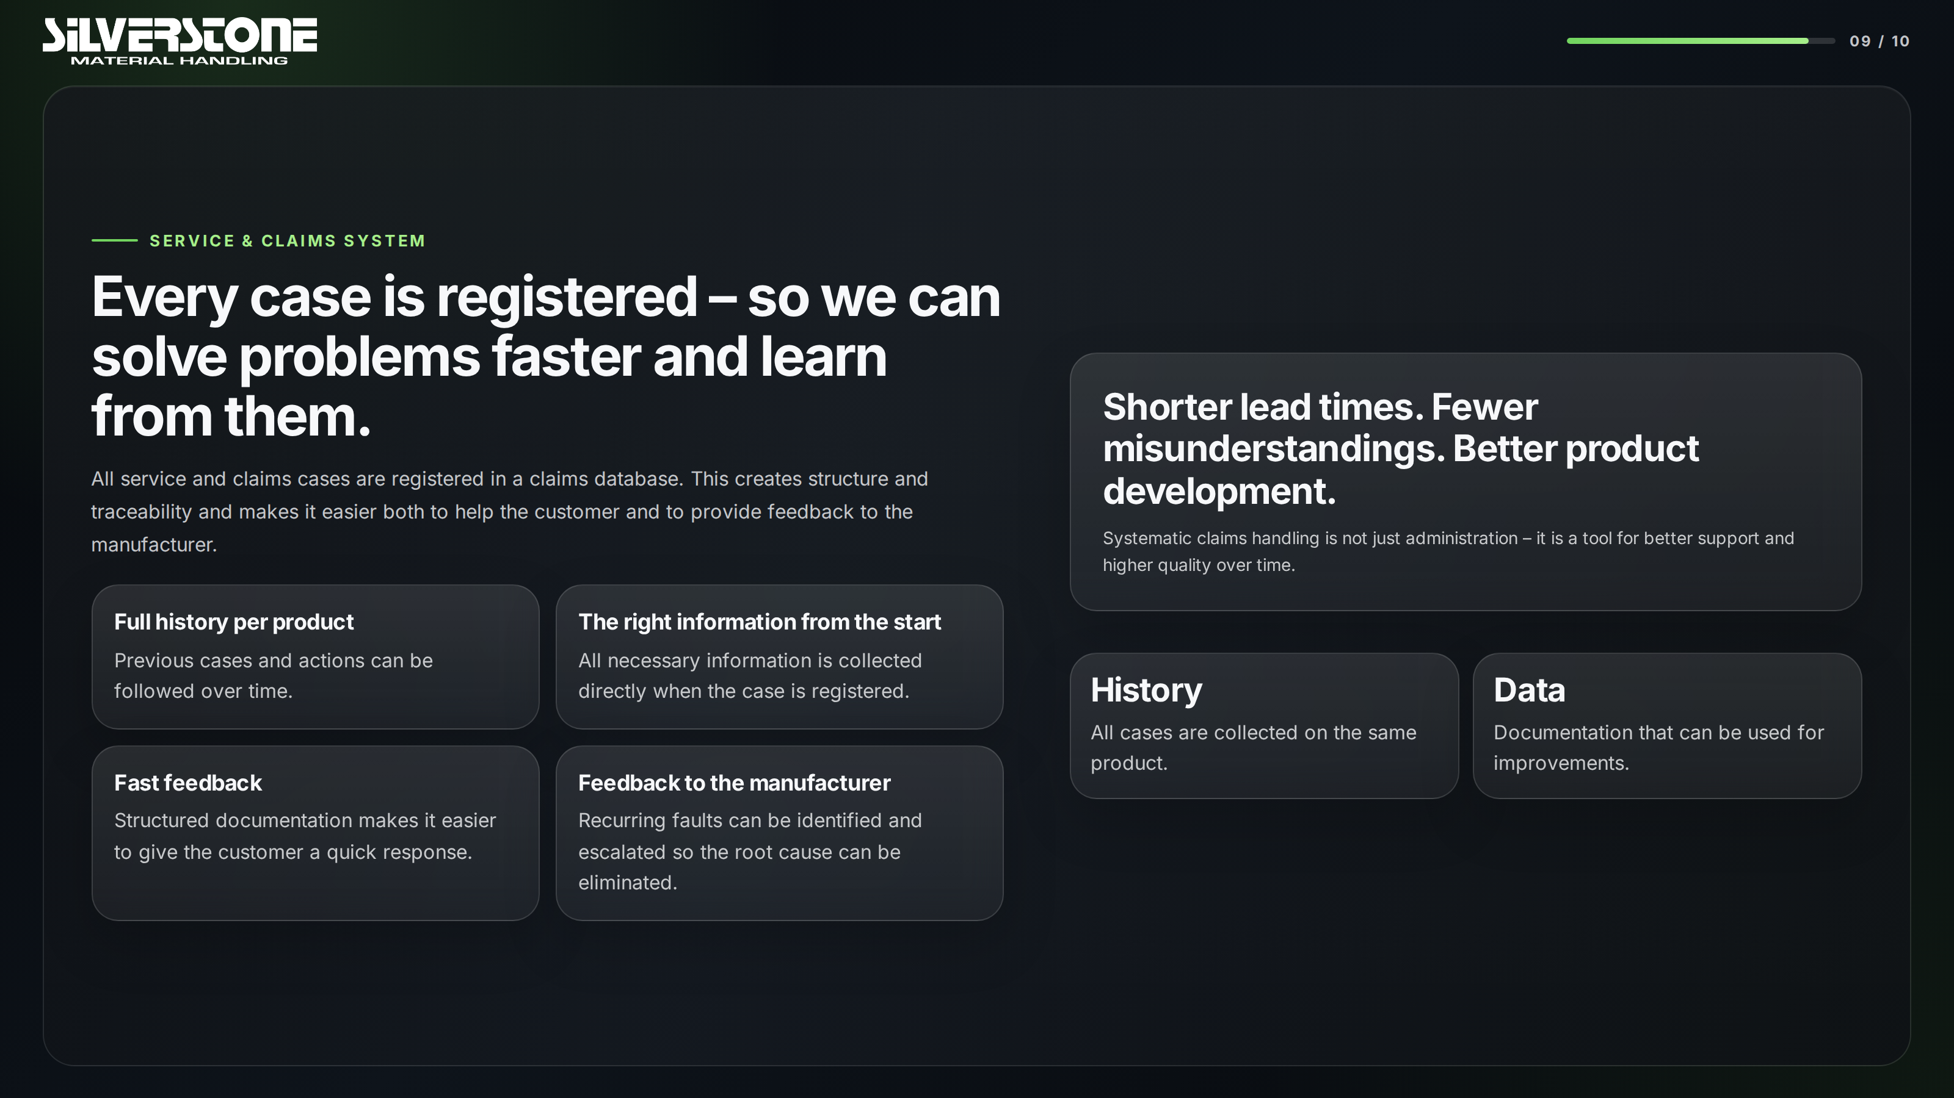
Notes:
Source: supplied Silverstone company presentation (HTML), original slide 18.

Slide 10
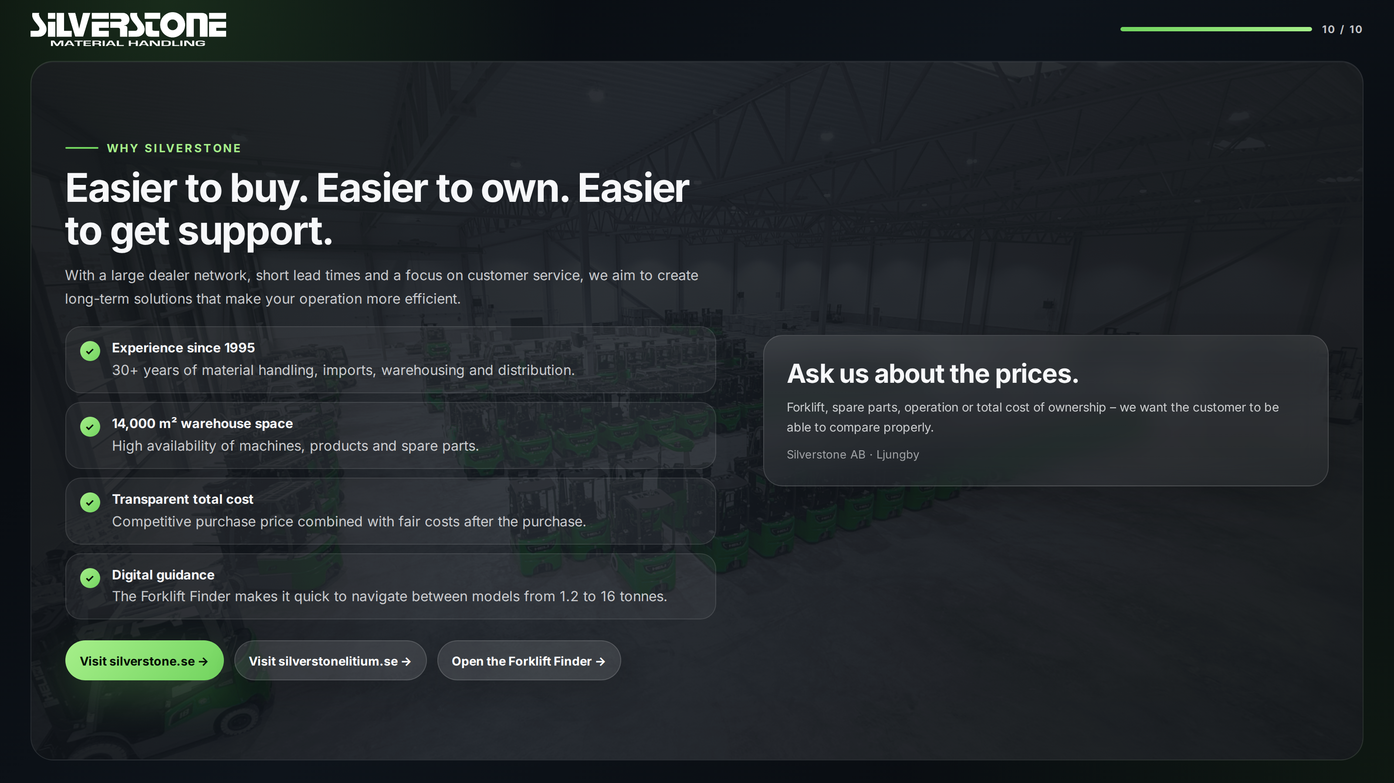
Notes:
Source: supplied Silverstone company presentation (HTML), original slide 19.

